Slide 1
Tesla GPL
Microbit project with sensors and micro engines

Slide 2
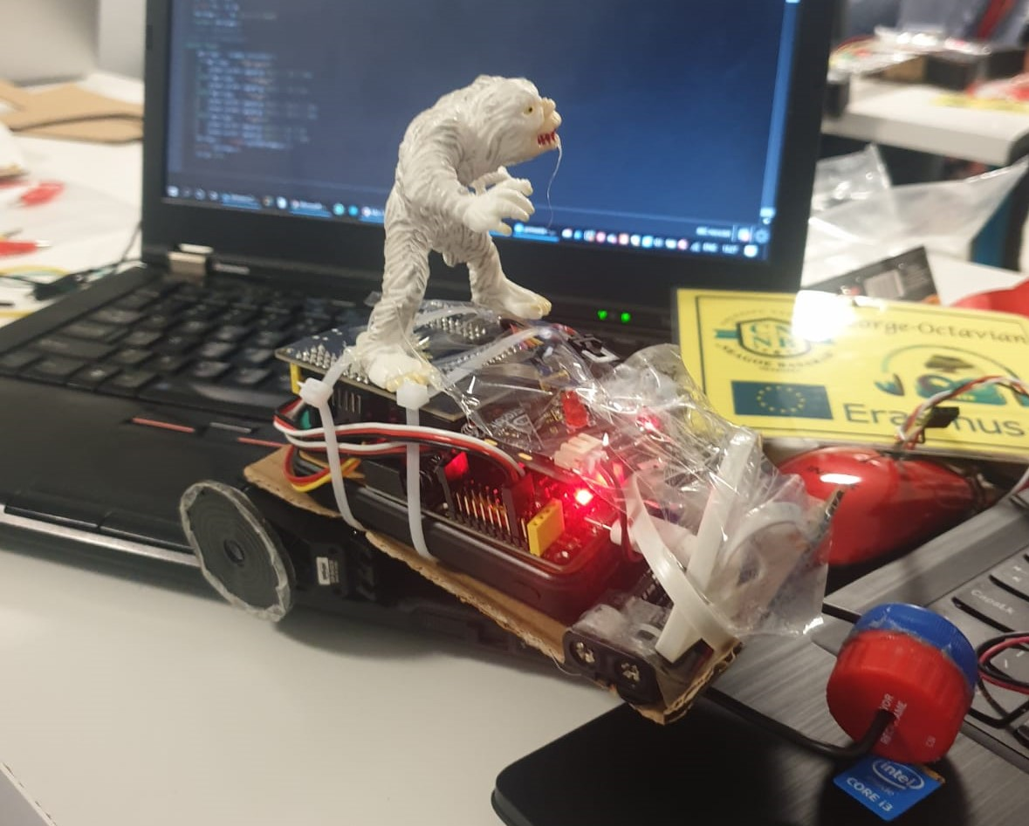
Project Description
Considering everything we have learned during our lessons, we have decided to design a radio controlled car, using three micro controllers, one to send the commends, while the other one would execute them.

Slide 3
Why a radio controlled car?
We have chosen this project because electric cars represent the future of transports due to them producing less pollution.
We consider this project our introduction to a future career in engineering and robotics, since this has been a dream for us ever since childhood.
Cars are also cool :)

Slide 4
What it does?
The controller emits radio signals to the car, determing it’s movements(left, right, front and back), also displaying the arrows of the movements
In addition, it has implemented a siren and a blue-red alternation of colours

Slide 5
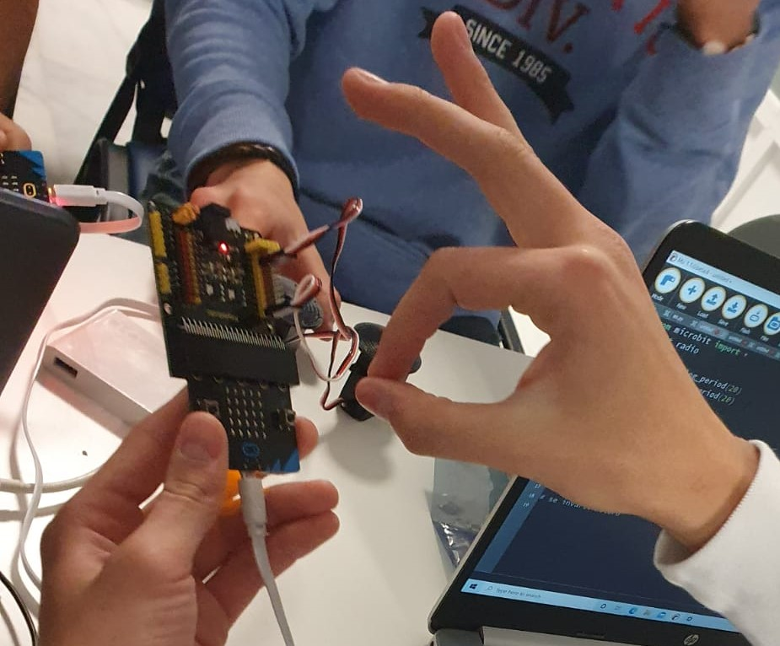
Project development
We started by establishing what materials we need, such as sensors, microbits, plenty of cables and many more.
After that, we gathered everything and made sure they all worked.
Then the real work started: we began by writing the codes and assembling the key parts of our device, while also writing this presentation.

Slide 6
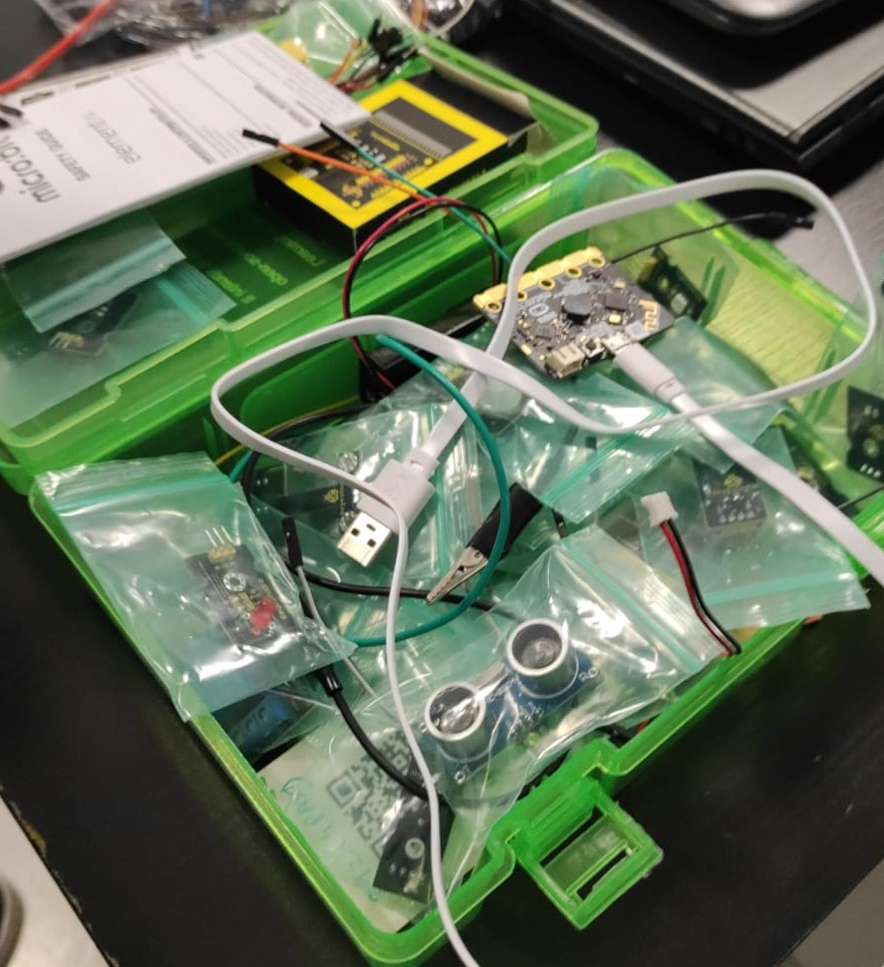
Components We Used
3 Micro controllers
A multitude of cables
2 Servomotors
1 Keystudio
Batteries
1Ultrasonic Sensor
2Ledlight

Slide 7
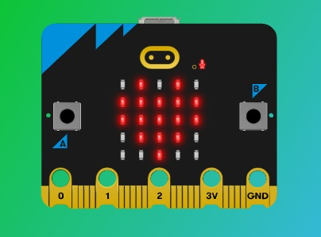
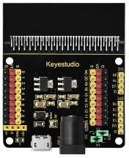
Microbit
The Micro Bit is an embedded system of free hardware based on ARM designed by the BBC for use in computer education in the UK
he Micro Bit was designed to encourage children to be actively involved in writing computer software and building new things, rather than being consumers of media

Slide 8
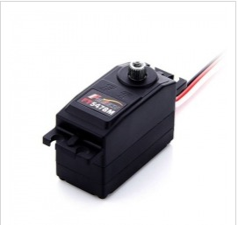
Servomotors
A servomotor is a rotary actuator or linear actuator that allows for precise control of angular or linear position, velocity and acceleration. It consists of a suitable motor coupled to a sensor for position feedback. It also requires a relatively sophisticated controller, often a dedicated module designed specifically for use with servomotors.

Slide 9
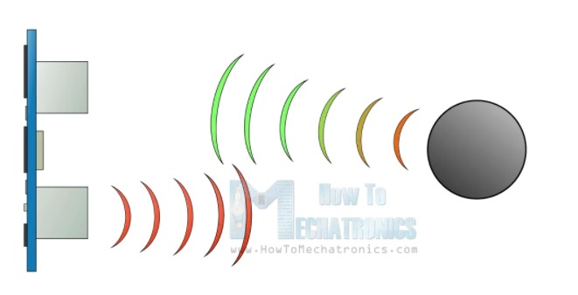
Ultrasonic Sensor
It emits an ultrasound at 40 000 Hz which travels through the air and if there is an object or obstacle on its path It will bounce back to the module. Considering the travel time and the speed of the sound you can calculate the distance.

Slide 10
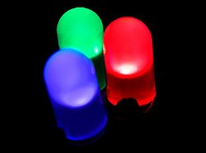
L.E.D.
Light-emitting diode (LED) is a semiconductor light source that emits light when current flows through it. Electrons in the semiconductor recombine with electron holes, releasing energy in the form of photons. The color of the light (corresponding to the energy of the photons) is determined by the energy required for electrons to cross the band gap of the semiconductor.

Slide 11
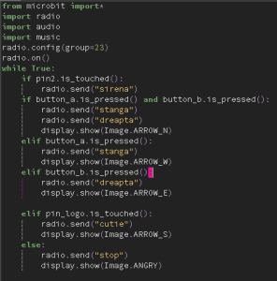
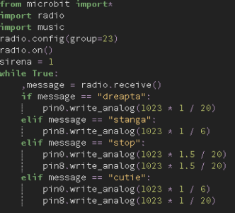
Transmitter Receiver

Slide 12
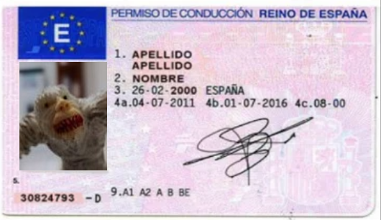
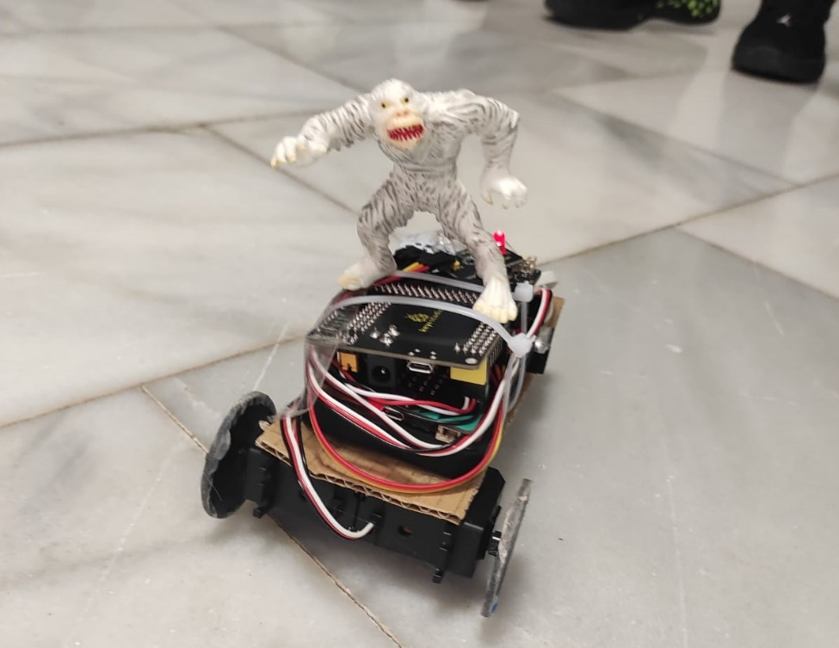
About our driver
chupacabra
Proffesional driver ,now sponsored by Tesla
Likes eating goats
Lovely white hair

Slide 13
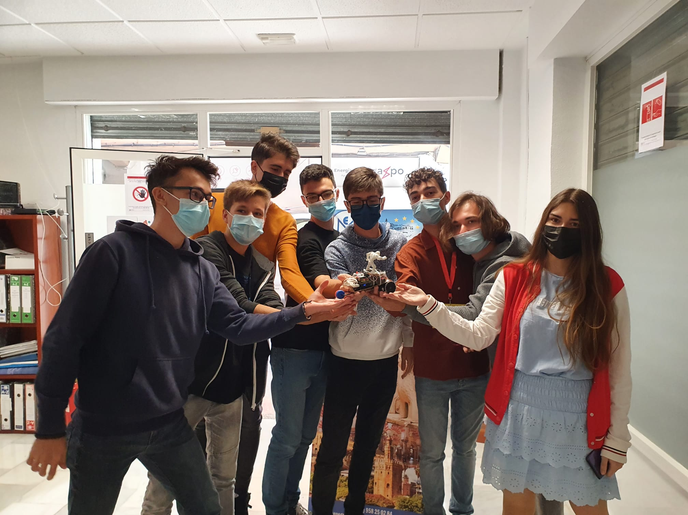
Team Members
Avram Alin Ioan
Tartau Bogdan Mihai
Constantin Emil Marian
Farcasi George Octavian
Savu Victor Stefan
Straseschi-Boboc Andreea Alina
Nedelcu Sebastian
Dogaru Mihail Danut

